Slide 1
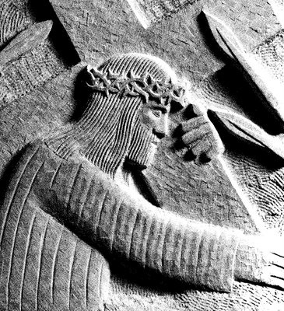
The Way of the Cross
through the eyes of others

Slide 2
From heav'n you came, helpless babe,
entered our world, your glory veiled;
not to be served but to serve
and give your life that we might live.
This is our God, the Servant King,
He calls us now to follow him,
to bring our lives as a daily offering
of worship to the Servant King.

Slide 3
1. Jesus is condemned to death
Pilate’s Story

Slide 4
There in the garden of tears,
my heavy load He chose to bear;
His heart with sorrow was torn,
'Yet not my will, but yours' He said.
This is our God, the Servant King,
He calls us now to follow him,
to bring our lives as a daily offering
of worship to the Servant King.

Slide 5
2. Jesus takes up his Cross
Zacchaeus’ Story

Slide 6
When I survey the wondrous cross
on which the prince of glory died,
my richest gain I count but loss,
and pour contempt on all my pride.

Slide 7
3. Jesus falls for the first time
The Rich Young Man’s Story

Slide 8
See from his head, his hands, his feet,
sorrow and love flow mingled down;
did e’er such love and sorrow meet,
or thorns compose so rich a crown!

Slide 9
4. Jesus meets his mother
The Widow of Nain’s Story

Slide 10
She gave her body as God’s shrine,
her heart to piercing pain;
she knew the cost of love divine,
when Jesus Christ was slain.

Slide 11
5. Simon helps Jesus carry his cross
Simon’s Story

Slide 12
Brother, sister, let me serve you,
let me be as Christ to you,
pray that I may have the grace
to let you be my servant too.

Slide 13
6. Veronica wipes the face of Jesus
Veronica’s Story

Slide 14
I will hold the Christlight for you
in the night-time of your fear;
I will hold my hand out to you,
speak the peace you long to hear.

Slide 15
7. Jesus falls the second time
The Soldier’s Story

Slide 16
Glory be to Jesus,
who, in bitter pains,
poured for me the life-blood
from his sacred veins.

Slide 17
8. Jesus comforts the women of Jerusalem
The Women’s Story

Slide 18
I will weep when you are weeping;
when you laugh, I’ll laugh with you.
I will share your joy and sorrow
till we’ve seen this journey through.

Slide 19
9. Jesus falls the third time
The Story of Hannah, Mother of Judas

Slide 20
In life, no house, no home
my Lord on earth might have;
in death, no friendly tomb
but what a stranger gave.
What may I say? Heaven was his home;
but mine the tomb wherein he lay.

Slide 21
10. Jesus is stripped of his garments
Balthazar’s Story

Slide 22
Why what hath my Lord done?
What makes this rage and spite?
He made the lame to run,
he gave the blind their sight.
Sweet injuries!
yet they at these
themselves displease,
and ‘gainst him rise.

Slide 23
11. Jesus is nailed to the Cross
Jethro’s Story – the Deaf Man

Slide 24
See from his head, his hands, his feet,
sorrow and love flow mingled down;
did e’er such love and sorrow meet,
or thorns compose so rich a crown!

Slide 25
12. Jesus dies on the Cross
John’s Story

Slide 26
Lift ye then your voices;
swell the mighty flood;
louder still and louder
praise the precious blood.

Slide 27
13. Jesus is taken down from the Cross
Joseph of Arimathea tells his Story

Slide 28
Were the whole realm of nature mine,
that were a present far too small;
love so amazing, so divine,
demands my soul, my life, my all.

Slide 29
14. Jesus is laid in the tomb
Nicodemus’ Story

Slide 30
Oft as earth exulting
wafts its praise on high,
angel-hosts rejoicing
make their glad reply.
Lift ye then your voices;
swell the mighty flood;
louder still and louder
praise the precious blood.

Slide 33
15. The Resurrection
Mary of Magdala tells her Story

